Slide 1
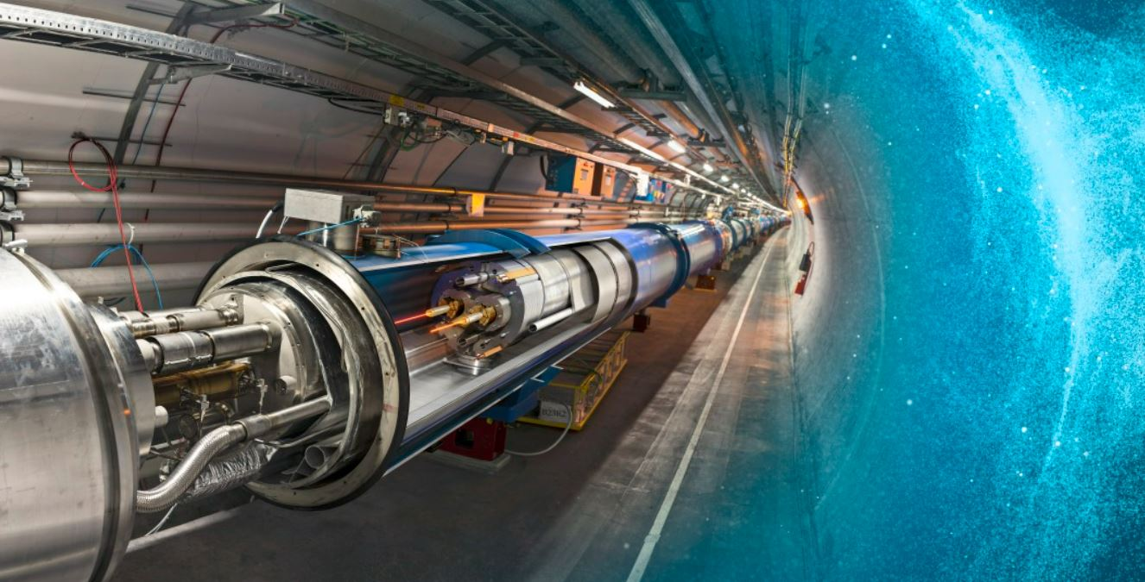

TINY BIG MAGNETIC PARTICLE ACCELERATOR (TBMPA)
Qailah Bhamjee
University of Cape Town
Supervised by Dr Simon Winberg

Slide 2
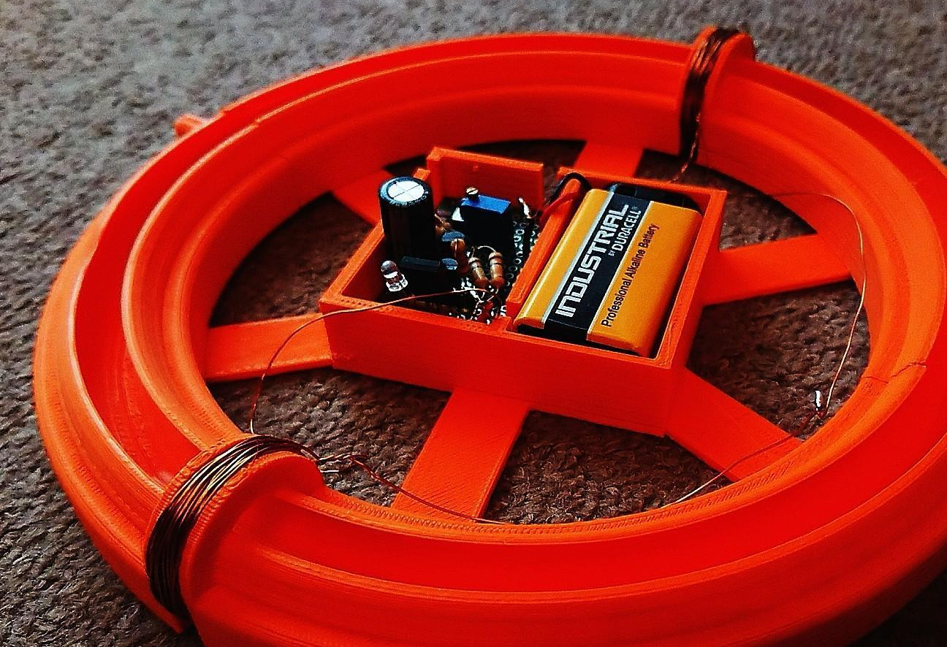
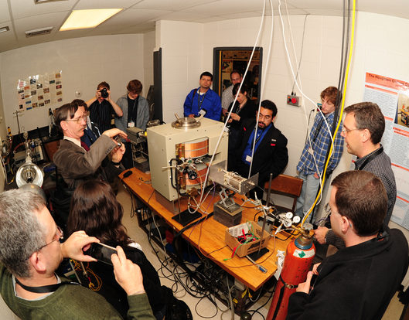
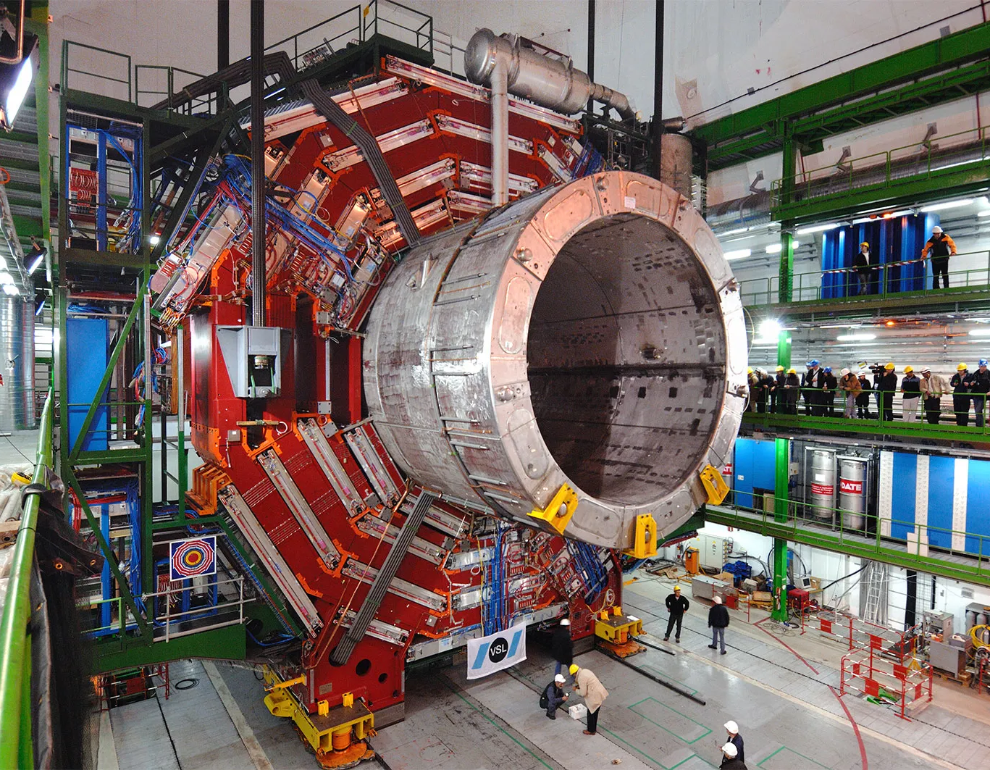
BACKGROUND

Slide 3
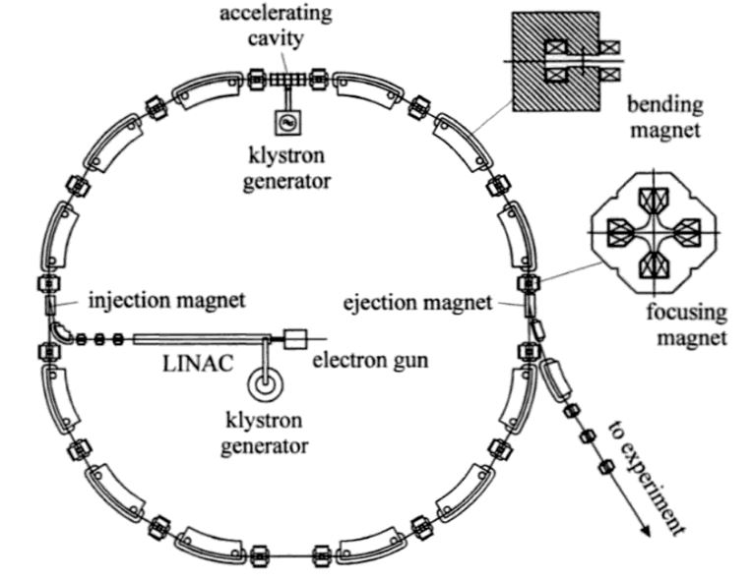
OBJECTIVES
The design considerations that are necessary for ensuring the safe and accurate operation of the accelerator
How magnets can be used effectively to move and adjust the speed of objects
The optimal timing for activating the magnets to control the object’s speed
The accurate detection of the moving object

Slide 4
APPROACH
Sensor Detection System
Embedded Control System
Main Accelerator
Particles
Particle track
Injection system
Electromagnets
Laser-based detection circuit
Electromagnet control circuit
STM Embedded platform

Slide 5
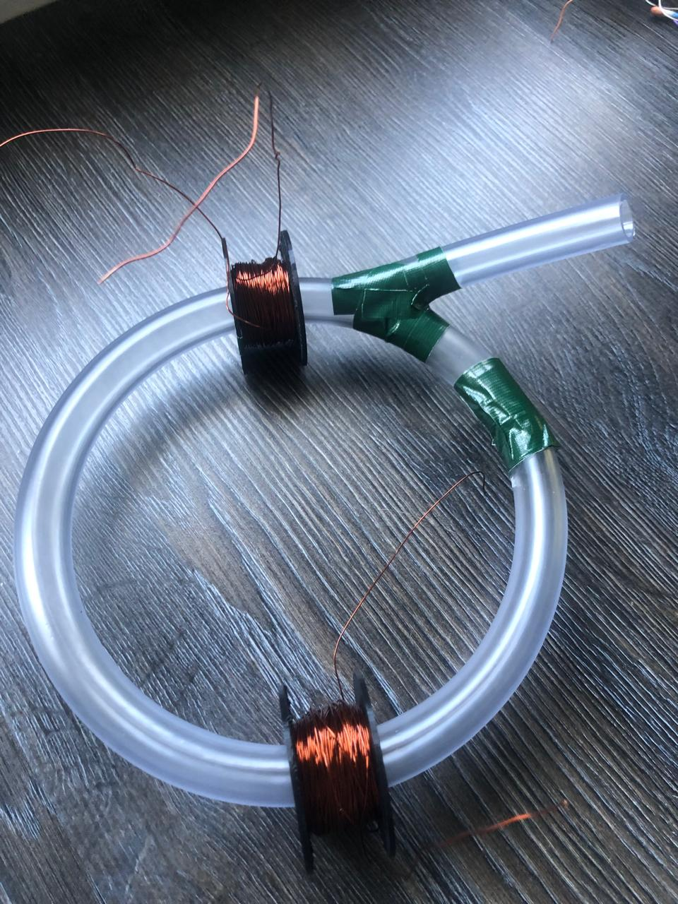
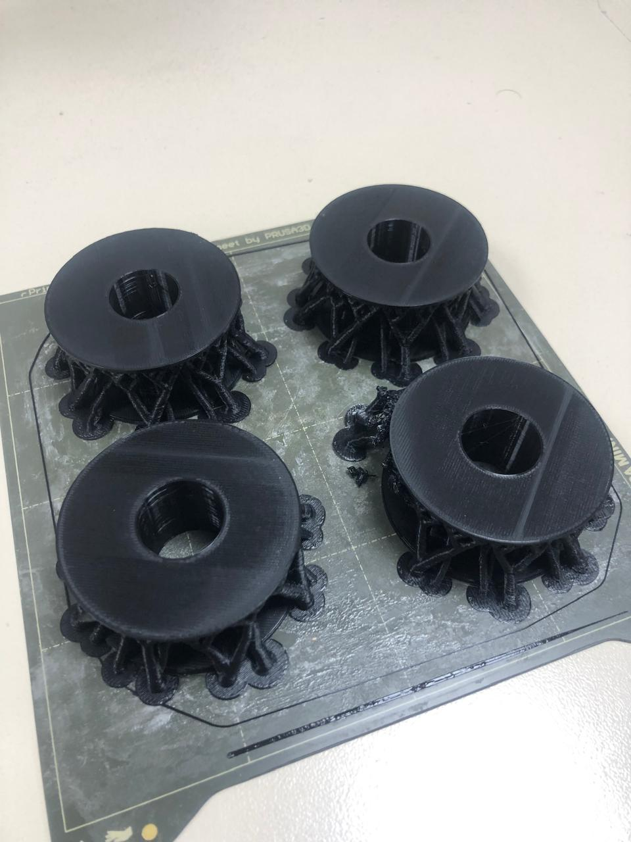
MAIN ACCELERATOR
Particles
solid ferrite stainless steel ball bearings
Particle track
Flexible, clear PVC tubing
Injection system
Linac
Electromagnets

Slide 6
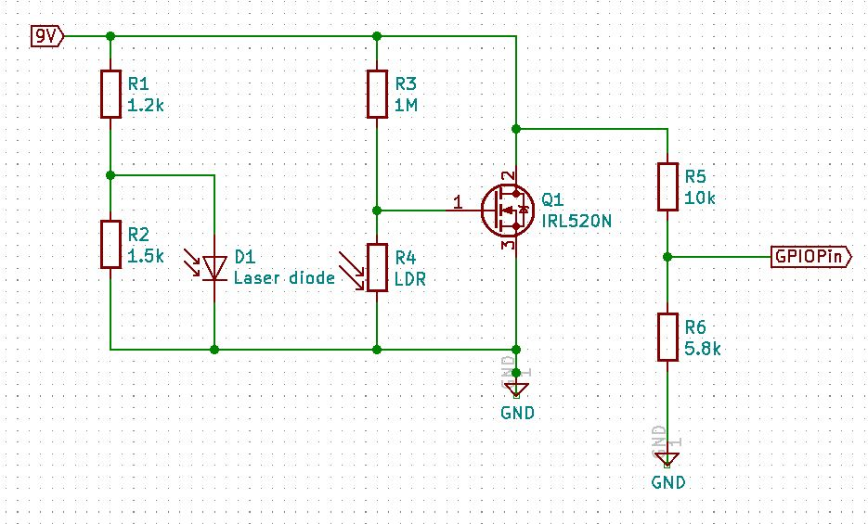
SENSOR DETECTION SYSTEM
Voltage divider configuration
MOSFET IRL250N
Provides an input to the embedded control system

Slide 7
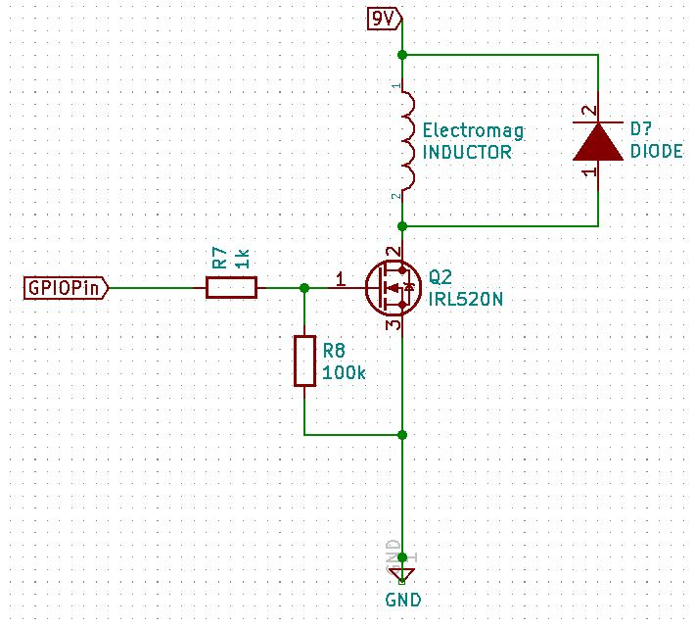
EMBEDDED CONTROL SYSTEM
Uses an STM32 microcontroller to control the timing and activation of electromagnets
When a ball bearing passes sensors placed on the track, the system records the time via interrupts, calculates the object's speed, and adjusts the magnet activations to maintain controlled acceleration

Slide 8
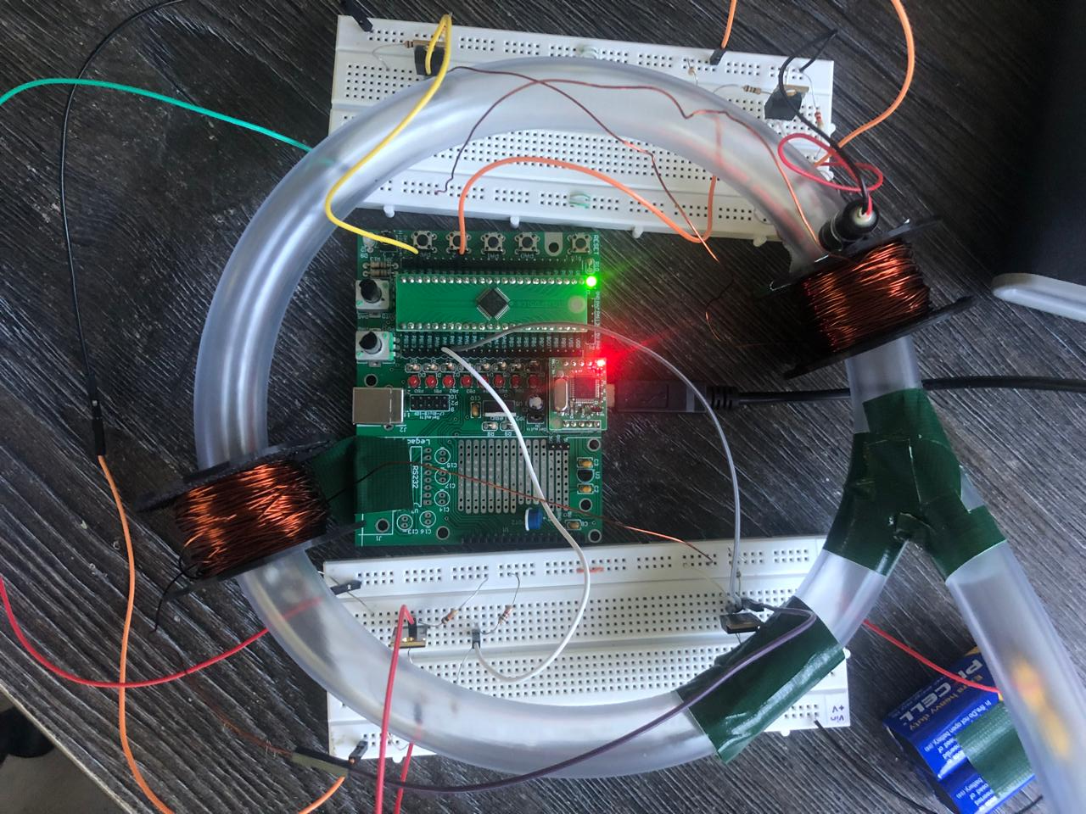
INTEGRATED SYSTEM

Slide 9
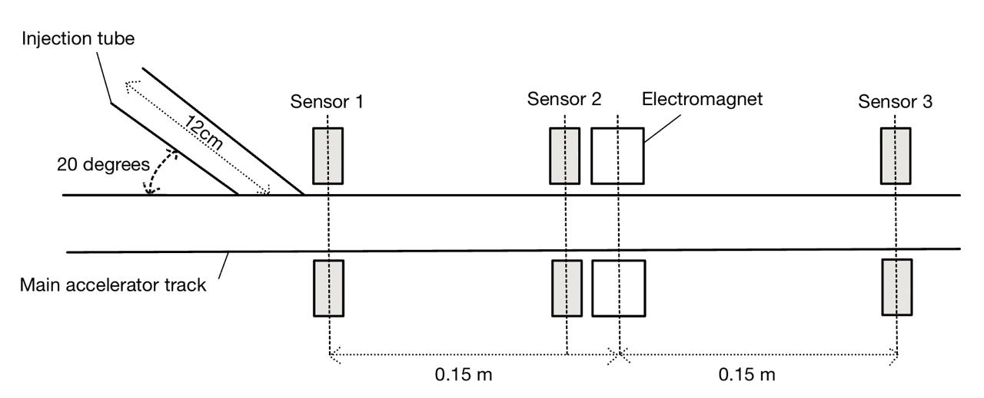
EXPERIMENTAL SETUP

Slide 10
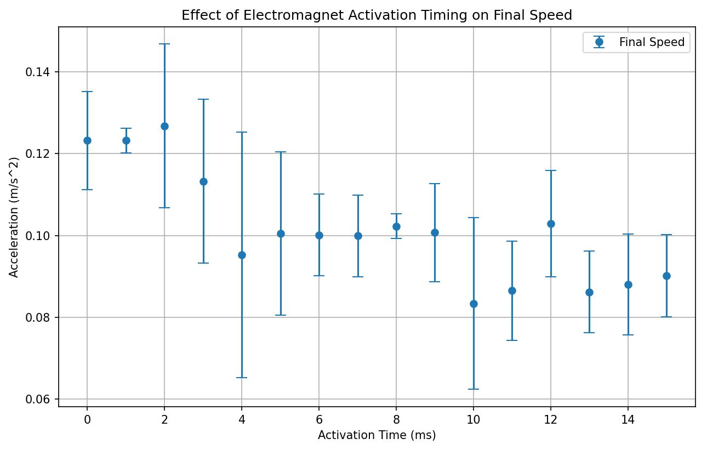
RESULTS

Slide 11
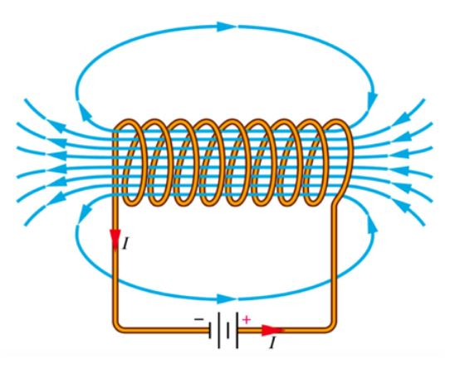
CONCLUSIONS
The activation timing of the electromagnet has a direct impact on the acceleration of the ball bearing
This confirms that precise object detection and timing control is critical to optimising performance
The electromagnet delay, timing accuracy, friction, and sensor precision can be further optimised to improve the efficiency of the system

Slide 12
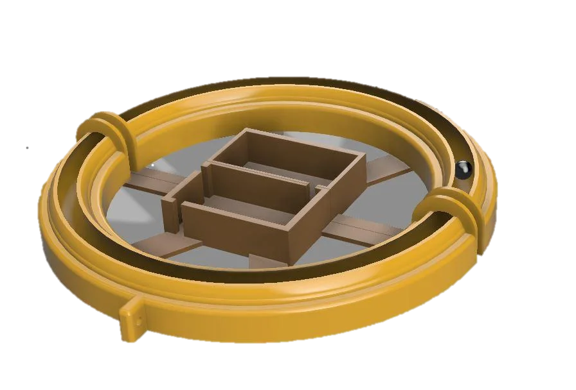
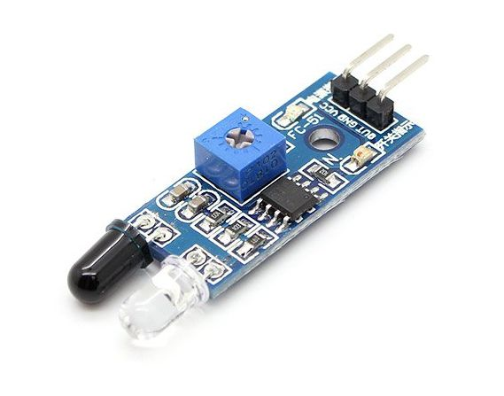
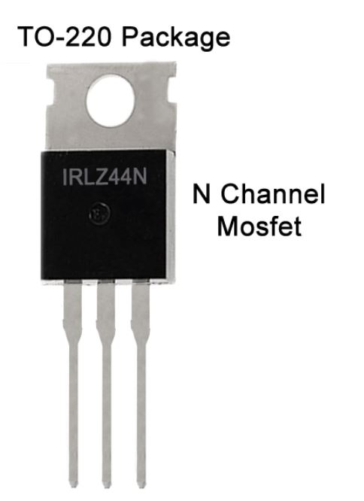
FUTURE IMPROVEMENTS
Improved sensor capabilities and detection accuracy
Better synchronisation of control system with particle motion
Optimising Mechanical Assembly for Performance
Infrared Sensor module
IRFZ44N Rectifier Power MOSFET
Instructables 3D printed (PLA) acceleration track

Slide 13
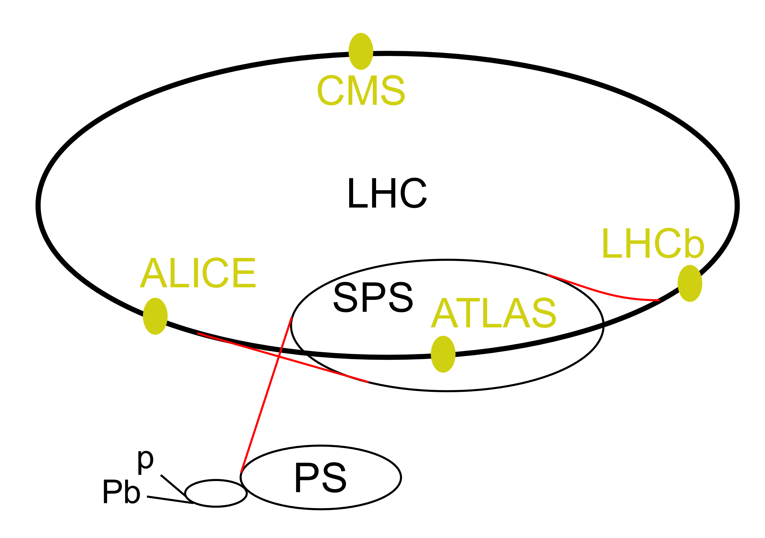
Future Research Directions
Collision dynamics study
Multi-particle synchronisation
Thermal effects on acceleration
Layout of CERN’s LHC complex

Slide 14
THANK YOU
Qailah Bhamjee
University of Cape Town
Supervised by Dr Simon Winberg

